Slide 1
Tools of
The trade
Omar Shehata

Slide 2
Who Am I?
Omar Shehata
Student at Alexandria University
Game Developer/Programmer
Making games for 6 years
Notes:
Introducing myself again in case someone didn’t attend previous talk

Slide 3
What tools should I use?
Notes:
This talk is concerned with this specific question, and will try to answer it

Slide 4
Outline
Define what a Game Engine is and the criteria with which we rate our GameDev tools
A look into various tools and platforms
Monetization

Slide 5
Let’s not reinvent the wheel
Use the tools that will get the job done
Build off the experiences of your predecessors
Stand on the shoulders of giants
Notes:
No matter how great of a programmer you are, building everything from scratch means
Others will beat you by building off the experience of everyone else

Slide 6
Game Engine
Audio
Input
Rendering
Animation
Fonts
Math/Physics
Notes:
These are all things the game engine is responsible for
You either find one, or you make one, most of the time you find one and create what’s missing

Slide 7
What are the criteria?
Performance
Portability
Stability
Ease of use
Developer Support
Notes:
How many people think performance is the most important factor?
I think ease of use is the most important

Slide 8
Your choice of tool depends as much on the tool as who you are

Slide 9
My Anecdote
Concerned Joe was successful as a flash game
Wanted to make it as a “real” game
Everyone says to use C++ because that’s what “real” games use
Asked Tommy Refenes (Super Meat Boy)
Notes:
And tommy said

Slide 10
“You my friend, don’t understand programming languages”
-Tommy Refenes
Notes:
So I thought, hey, akeed howa beyefham aktar, let’s use C++

Slide 11
So we used C++
Started writing a wrapper for OpenGL, SDL and Box2d
Had so much control, but a month to set up the basic engine (movement, animation etc.)
Realized I could have done the same thing in one day with Flash
It lagged
Notes:
This isn’t going to work
It would have been better with flash because I’m used to it, and there’s already so much coded to help me

Slide 12
What’s wrong with flash?
“Nothing, it just doesn’t make Xbox games, and I already have a large personal codebase for C++”
-Tommy Refenes
Notes:
So he chose C++ because
-He’s experienced with it and can get things done quick
-He doesn’t have to reinvent the wheel
-It targets the platform he wants

Slide 13
Choose the tool that fits you and the job
Notes:
Two people using the same tool, one could be best choice other could be worst
Malaksh da3wa el nas el tanya bet2ool eh

Slide 14
The best games in game jams
Titan Souls - Flash (#1 Ludum Dare 28)
Probe Team – Unity (#1 Ludum Dare 27)
Inside My Radio – GameMaker (#2 Innovation Ludum Dare 23)
Tiny Timmy And Big Bill – Flash (#1 Innovation Ludum Dare 23)
Notes:
So even something like game maker can make great things
Belzabt game maker el nas beta7takero

Slide 15





Notes:
Such an awesome game, made with game maker, ONE guy made it
I hope this proves that, the only thing that matters is if the tool can get the job done

Slide 16

Notes:
Pro’s and cons

Slide 17
Why Flash
One of the fastest ways to prototype
Very easy distribution
Useful to learn

Slide 18
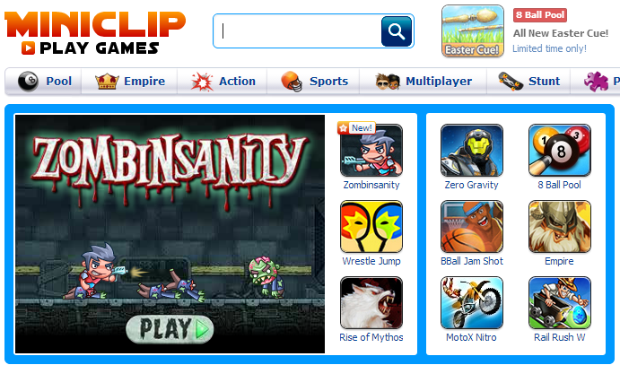
Why Flash

Slide 19
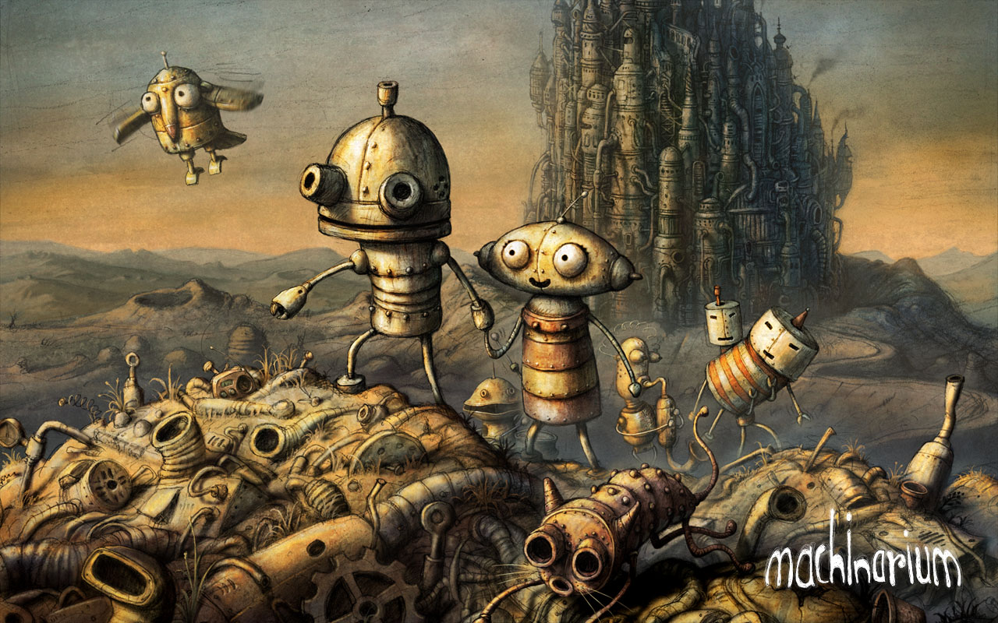
Why Flash

Slide 20

Why Flash

Slide 21
Why Flash
The Stage3D APIs in Flash Player and Adobe AIR offer a fully hardware-accelerated architecture that brings stunning visuals across desktop browsers and iOS and Android apps enabling advanced 2D and 3D capabilities.

Slide 22
Why not Flash?
Dependant on Adobe (may stop supporting certain feature)
Flash IDE is not very stable for large projects

Slide 23

One language, everywhere

Slide 24

Why HaXe

Slide 25
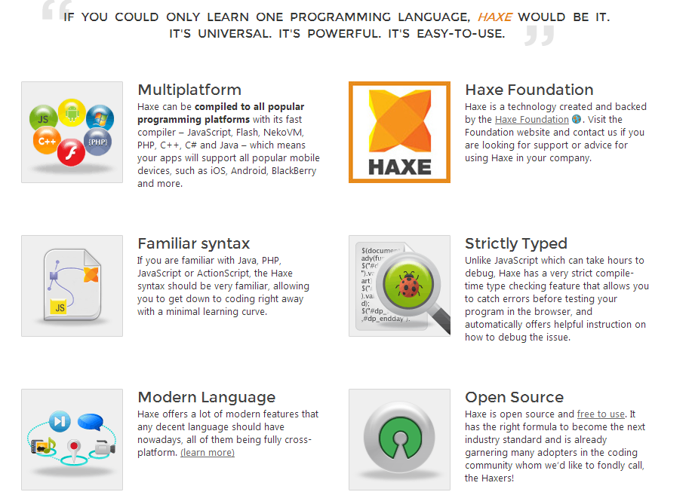

Slide 26
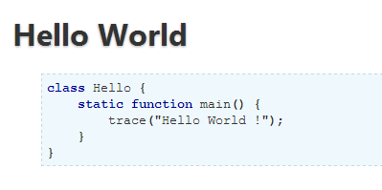
Why HaXe

Slide 27
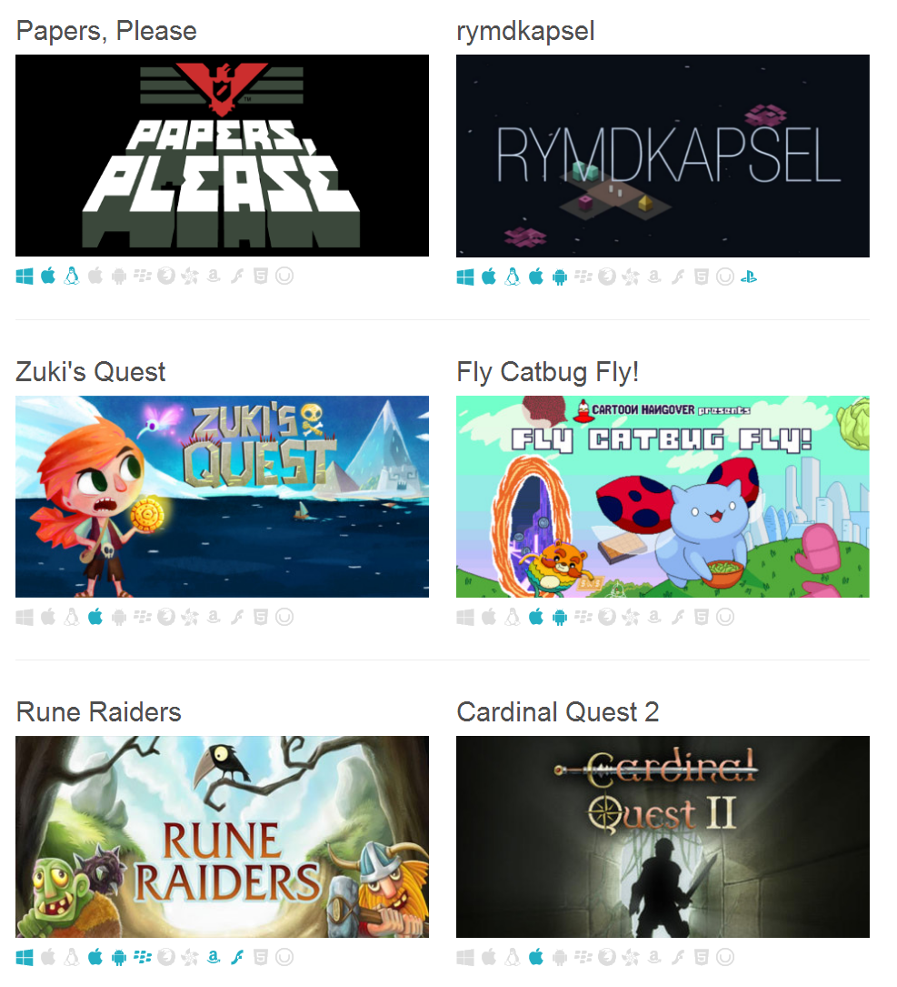
Why HaXe

Slide 28
Why not HaXe?
Lack of support

Slide 29


Slide 30
Why Unity?
Possibly the easiest way to make 3D
It’s fully-made game engine, does almost everything
Has an asset store
Exports to a lot of platforms
Supports Javascript, C#, UnityScript

Slide 31

Why Unity?

Slide 32

Why Unity?

Slide 33
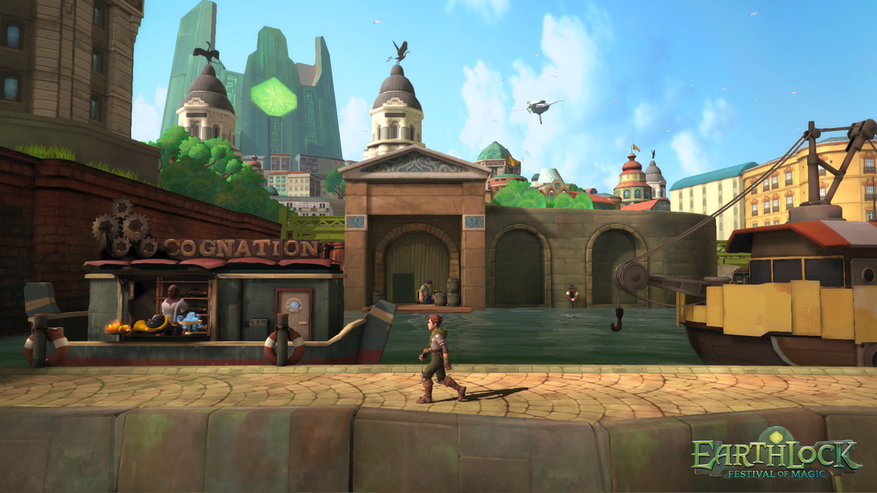
Why Unity?

Slide 34
Why Not Unity?
The engine is a “black box”, not open
Not made for 2D (recently fixed)
The market has a lot of “cookie-cutter” games

Slide 35
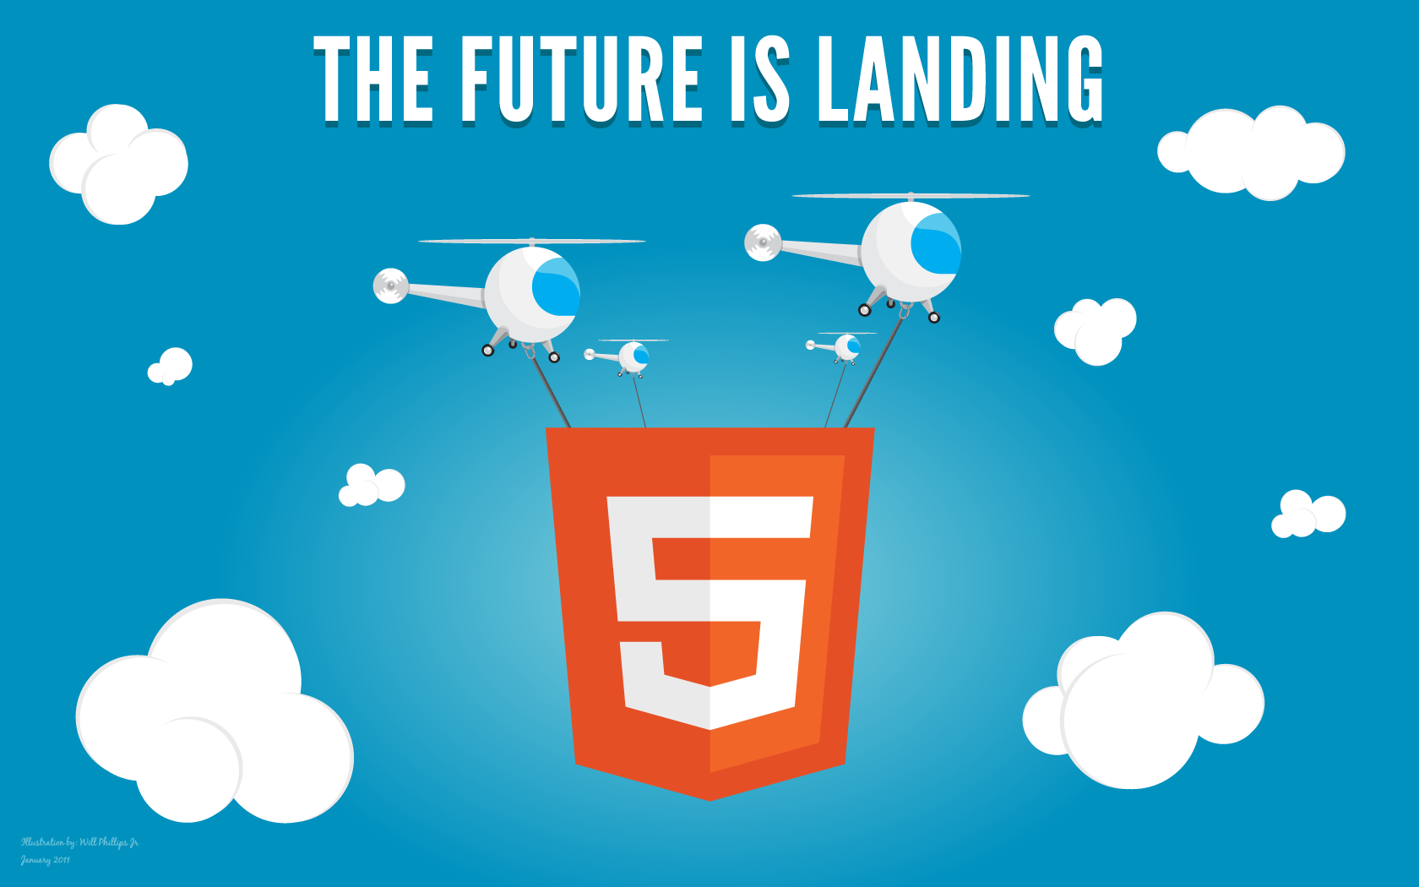

Slide 36
Why HTML5?
It works on anything that has a browser

Slide 37
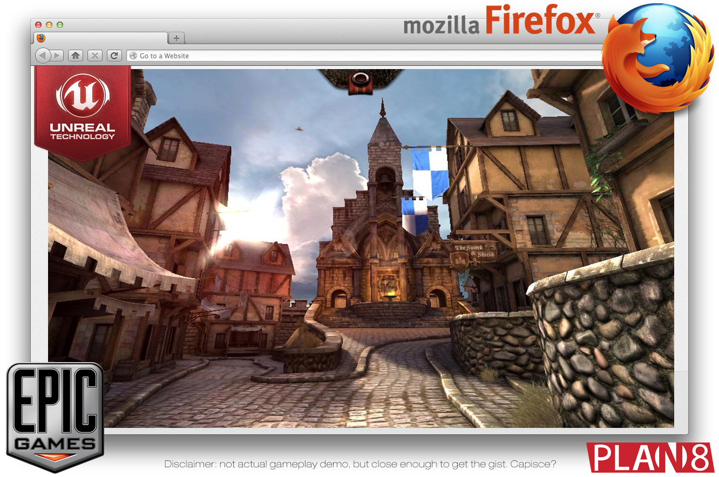
Why HTML5?

Slide 38
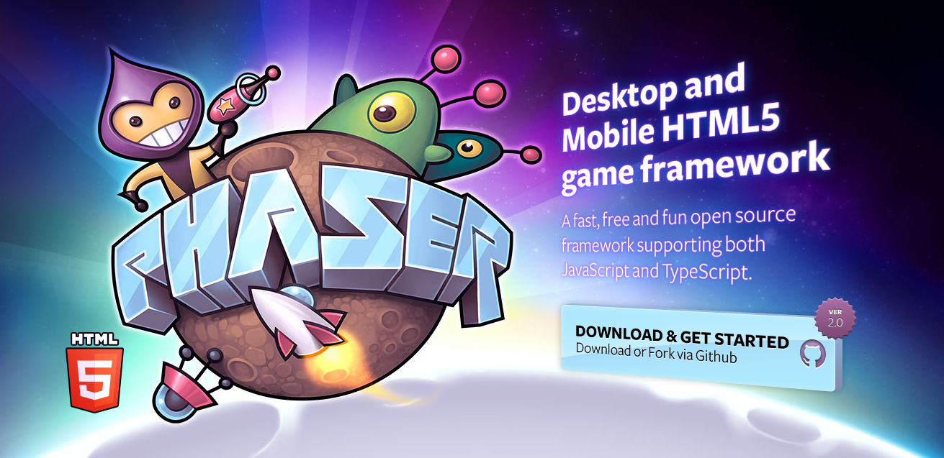
Html5 Frameworks

Slide 39
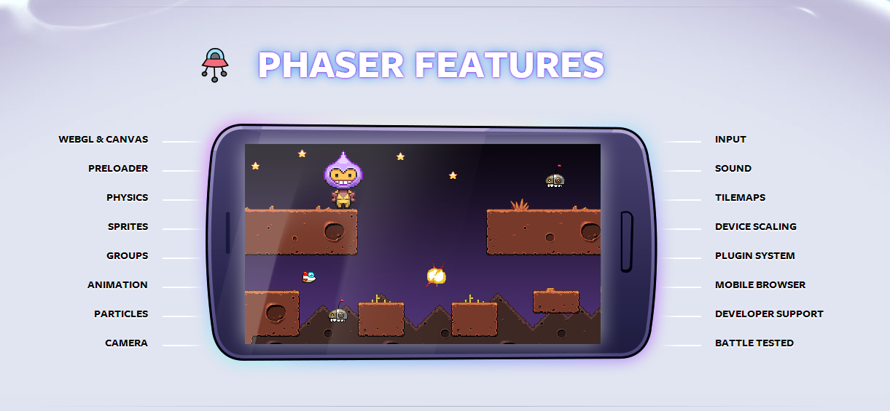
Html5 Frameworks

Slide 40
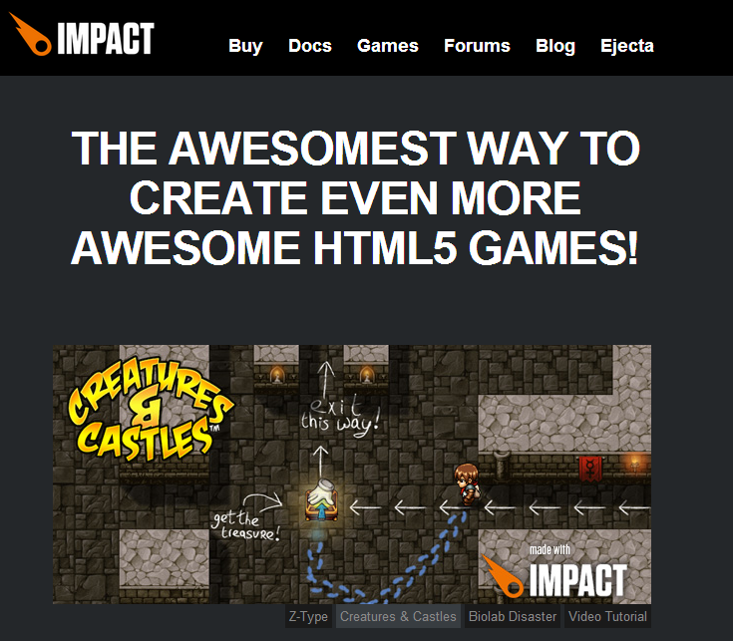
Html5 Frameworks

Slide 41
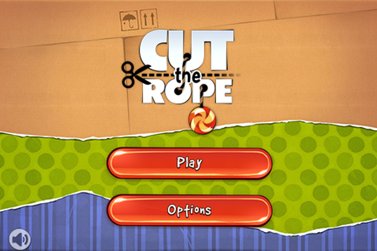
Why HTML5

Slide 42
Why not Html5?
Various browser issues
It’s new
Notes:
New may be good or bad, mention crosscode

Slide 43


Slide 44
Why Love?
So you can say “My game is made with love!”
Great for cross-platform computer games (PC/Mac/Linux)
Open Source
Easy to use
Great community

Slide 45
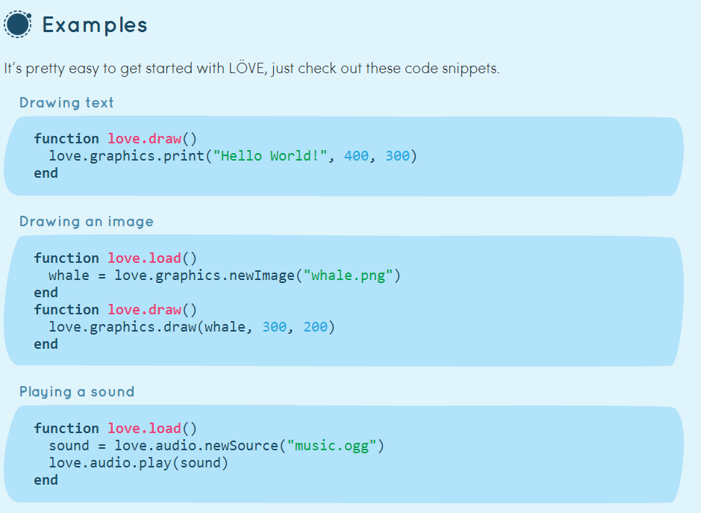
Why Love?

Slide 46
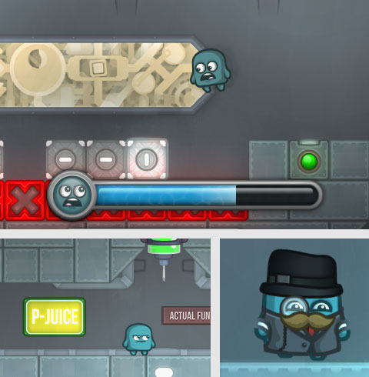
Why Love?

Slide 47
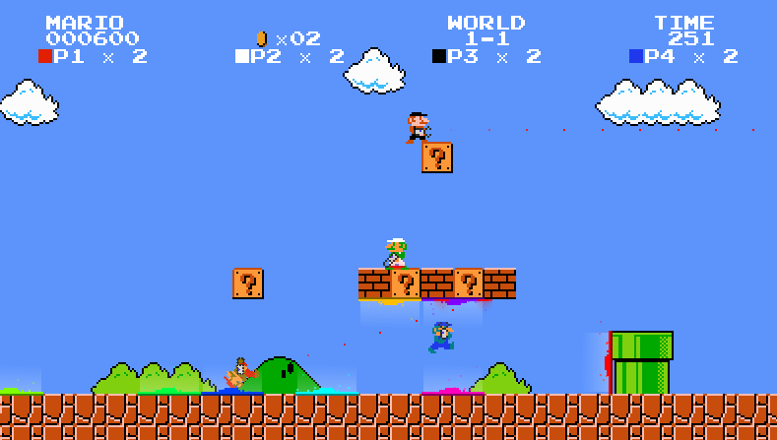
Why Love?

Slide 48
Why not Love?
No web or mobile support
Limited filesystem
Forces you to use Lua

Slide 49
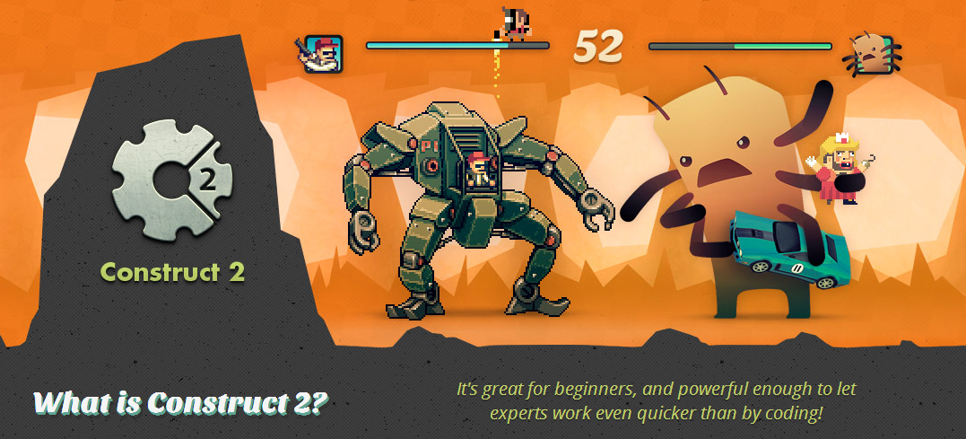

Slide 50
Why Construct 2?
Exports for web and mobile
Very easy and quick

Slide 51
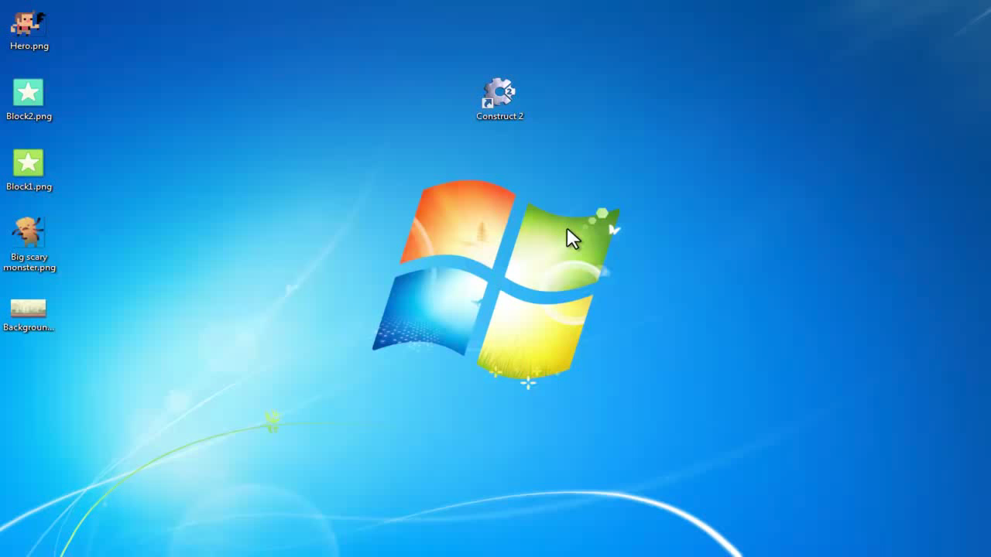

Slide 52
Why not Construct 2?
As a game maker, may not have full control
Not free

Slide 53

Game Maker Studio

Slide 54
Why Game Maker?
Can publish to web, desktop, mobile and soon, PS4
Easy to use
Gives you control and a lot of features

Slide 55

Why Game Maker?

Slide 56
Why not Game Maker 2?
As a game maker, may not have full control
Not free

Slide 57

Stencyl

Slide 58
Why Stencyl?
Exports to Flash, Windows, Mac, Linux, Android and iOS
Geared towards web and mobile
No programming required

Slide 59
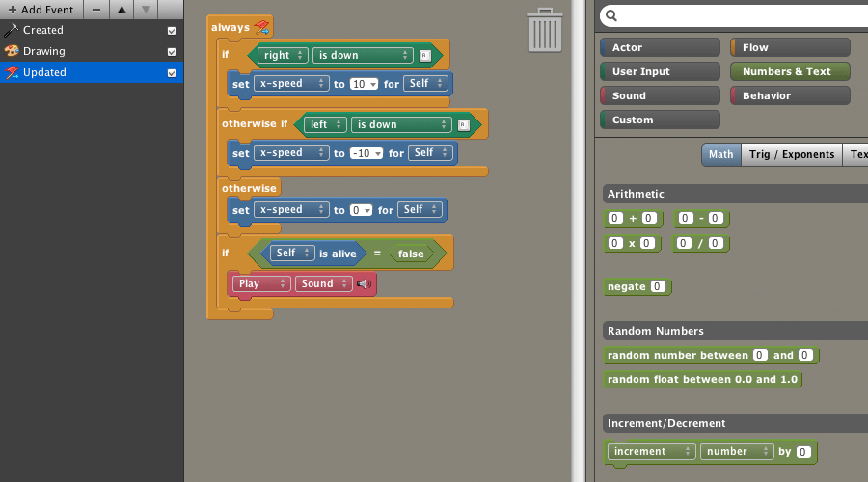

Slide 60
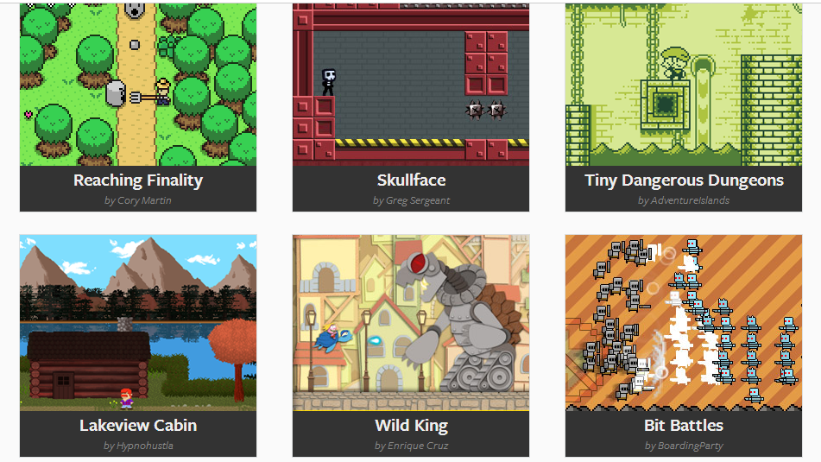

Slide 61
Why not Stencyl?
Not free

Slide 62
Twine
Twine is an open-source tool for telling interactive, nonlinear stories.

Slide 63
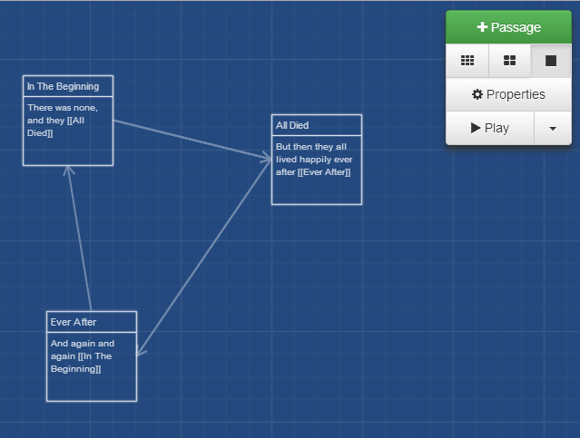
Twine

Slide 64


Slide 65
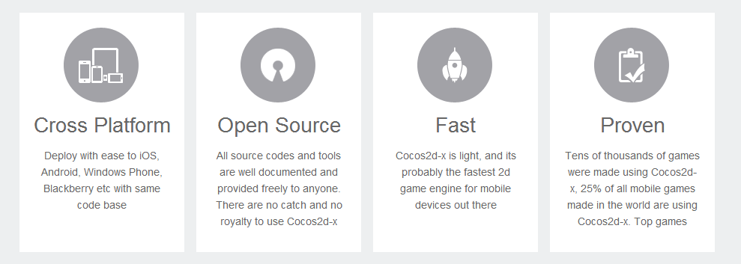
Why Cocos2dx?

Slide 66


Slide 67
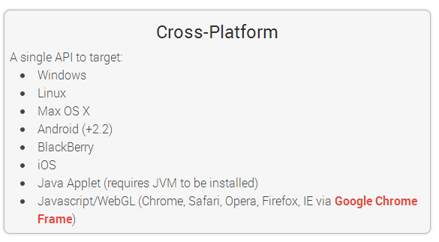
Why Libgdx?

Slide 68

Box2D

Slide 69
Box2D is a physics engine

Slide 70

Games powered by Box2d

Slide 71

Games powered by Box2d

Slide 72

Games powered by Box2d

Slide 73
Games powered by Box2d
Almost every single 2d game built with physics

Slide 74
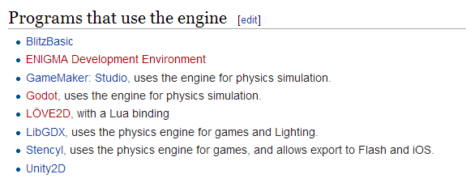
It’s ported everywhere

Slide 75
Monetization
With ads
Freemium
Classic downloadable model
Bundles are popular nowadays

Slide 76
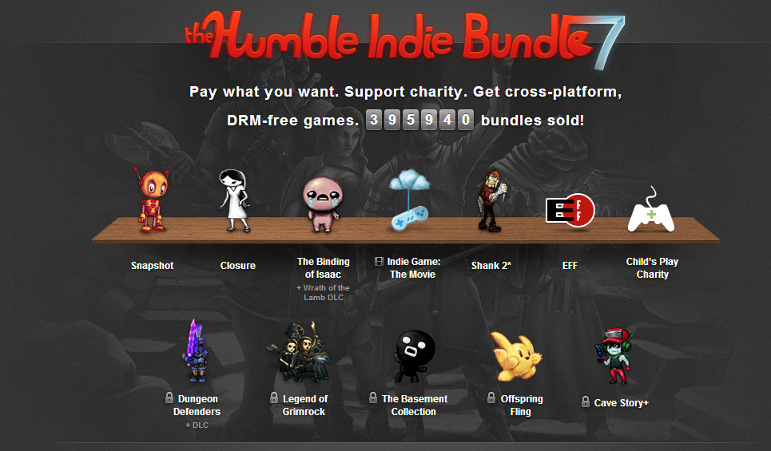

Slide 77

www.fgl.com

Slide 78
www.catreloaded.org/bootcamp/resources Thank you!

